Slide 2
To Display Information and accept Input From User we learn different HTML Tags
Empty Tags as well as Body Tags we know
With HTML5 we are easily added video and audio file also
<video width="320" height="240" controls> <source src="movie.mp4" type="video/mp4"> Your browser does not support the video tag. </video>

Slide 3
When we need to add videos in html we need to convert video in some specific format which is difficult
Now a days videos are easily available on Youtube so we can add those videos directly
For that we required id for that video
https://www.youtube.com/watch?v=Jyy0ra2WcQQ

Slide 4
To add You tube video we need to use iframe tag
<iframe width="420" height="345" src="https://www.youtube.com/embed/Jyy0ra2WcQQ">
</iframe>

Slide 5
iframe
An iframe, or Inline Frame, is an HTML element represented by the <iframe> tag. It functions as a 'window' on your webpage through which visitors can view and interact with another webpage from a different source.
Iframes are used for various purposes like:
Embedding Multimedia: Easily integrate videos, audio, or animations from platforms like YouTube, etc.
Including Maps: Embed maps from services like Google Maps directly into your site.
Loading Forms and Widgets: Incorporate forms or widgets from other sources without writing complex code.

Slide 6
Hyperlink
We are using <a > tag for adding hyperlink
When we click on Hyperlink resultant page is open in same Browser Window
So if we want to open in new window then we need to use one more attribute for <a > tag
<a href=“” target= “”>Link1 </a>
_self - Default. Opens the document in the same window/tab as it was clicked
_blank - Opens the document in a new window or tab

Slide 7
Input Elemenets
We can accept Input from user with the help of <input type=“”> tags
For input tag name attribute is important
to add data in url
With that name attribute we have another attribute id also which is used in css and Javascript
Name can be same to make a group but id should be unique only

Slide 8
Attributes of input tags
<input >
type --- specify type of input elements
name - used to pass data to next page
value - display default content
Size default value 20 we can change
Maxlength
Min and max and others

Slide 9
CSS
CSS is the language we use to style a Web page.
CSS stands for Cascading Style Sheets
CSS describes how HTML elements are to be displayed
External stylesheets are stored in CSS files

Slide 10
CSS Syntax
A CSS rule consists of a selector and a declaration block:
<selector> {<property>:<value>}
E.g p { color: red; text-align: center; }

Slide 11
Types of Selector
Element Selectors
- All particular element is affected
id Selectors
Class Selectors for all elemenets
Class Selectors for particular elements
Grouping
Multiple class

Slide 12
Type of CSS
Inline CSS
<h1 style="color:blue;text-align:center;">This is a heading</h1>
Internal CSS
<style> tag
External CSS – file with extension .css
<link rel="stylesheet" href="mystyle.css">

Slide 13
CSS Colors
In CSS, colors are specified by using a predefined color name, or with a RGB, HEX, HSL, RGBA, HSLA value.
<h1 style="background-color:DodgerBlue;">Hello World</h1>
<h1 style="background-color:rgb(255, 99, 71);">...</h1> <h1 style="background-color:#ff6347;">...</h1> <h1 style="background-color:hsl(9, 100%, 64%);">...</h1> <h1 style="background-color:rgba(255, 99, 71, 0.5);">...</h1> <h1 style="background-color:hsla(9, 100%, 64%, 0.5);">...</h1>

Slide 14
CSS Borders - Applying Border
CSS Margin The CSS margin properties are used to create space around elements, outside of any defined borders.
Margins define the distance between an element's border and the surrounding elements.

Slide 15
CSS Padding
The CSS padding properties are used to generate space around an element's content, inside of any defined borders.
With CSS, you have full control over the padding. There are properties for setting the padding for each side of an element (top, right, bottom, and left), and a shorthand property for setting all the padding properties in one declaration.

Slide 16
The CSS Box Model
In CSS, the term "box model" is used when talking about web design and layout.
The CSS box model is essentially a box that wraps around every HTML element.
Every box consists of four parts: content, padding, borders and margins.
The image below illustrates the CSS box model:

Slide 17
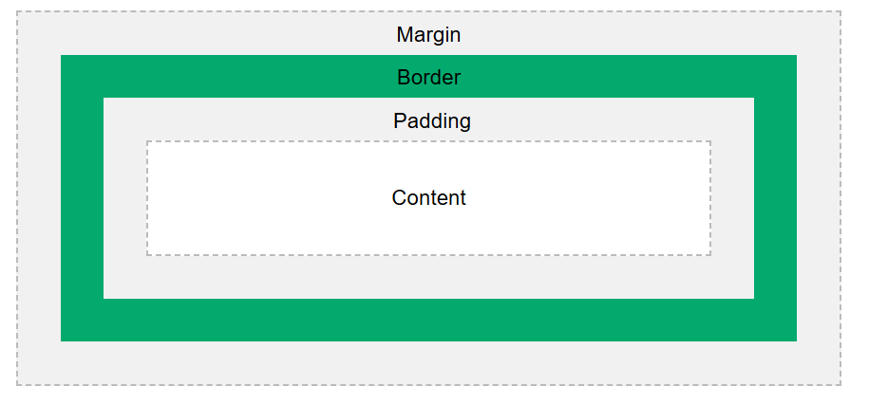

Slide 18
Explanation of the different parts (from innermost part to outermost part):
Content - The content of the box, where text and images appear
Padding - Clears an area around the content. The padding is transparent
Border - A border that goes around the padding and content
Margin - Clears an area outside the border. The margin is transparent

Slide 19
Font Selection
Font Selection is Important
Choosing the right font has a huge impact on how the readers experience a website.
The right font can create a strong identity for your brand.
Choosing a font that is easy to read is important. It is also important to choose a good color and size for your font.

Slide 20
.p1 { font-family: "Times New Roman", Times, serif; }
CSS Generic Font Families
Serif fonts - have a small stroke at the edges of each letter. They create a sense of formality and elegance.
Sans-serif fonts - have clean lines (no small strokes attached). They create a modern and minimalistic look.
Monospace fonts - here all the letters have the same fixed width. They create a mechanical look.
Cursive fonts - imitate human handwriting.
Fantasy fonts - are decorative/playful fonts.
All the different font names belong to one of the generic font families.

